Slide 1
Origins and consequences of chromosome pathology

Slide 2
Meiosis in chromosomally normal persons
Diploid → Haploid & variation creation
Differences in timing between the two sexes

Slide 3
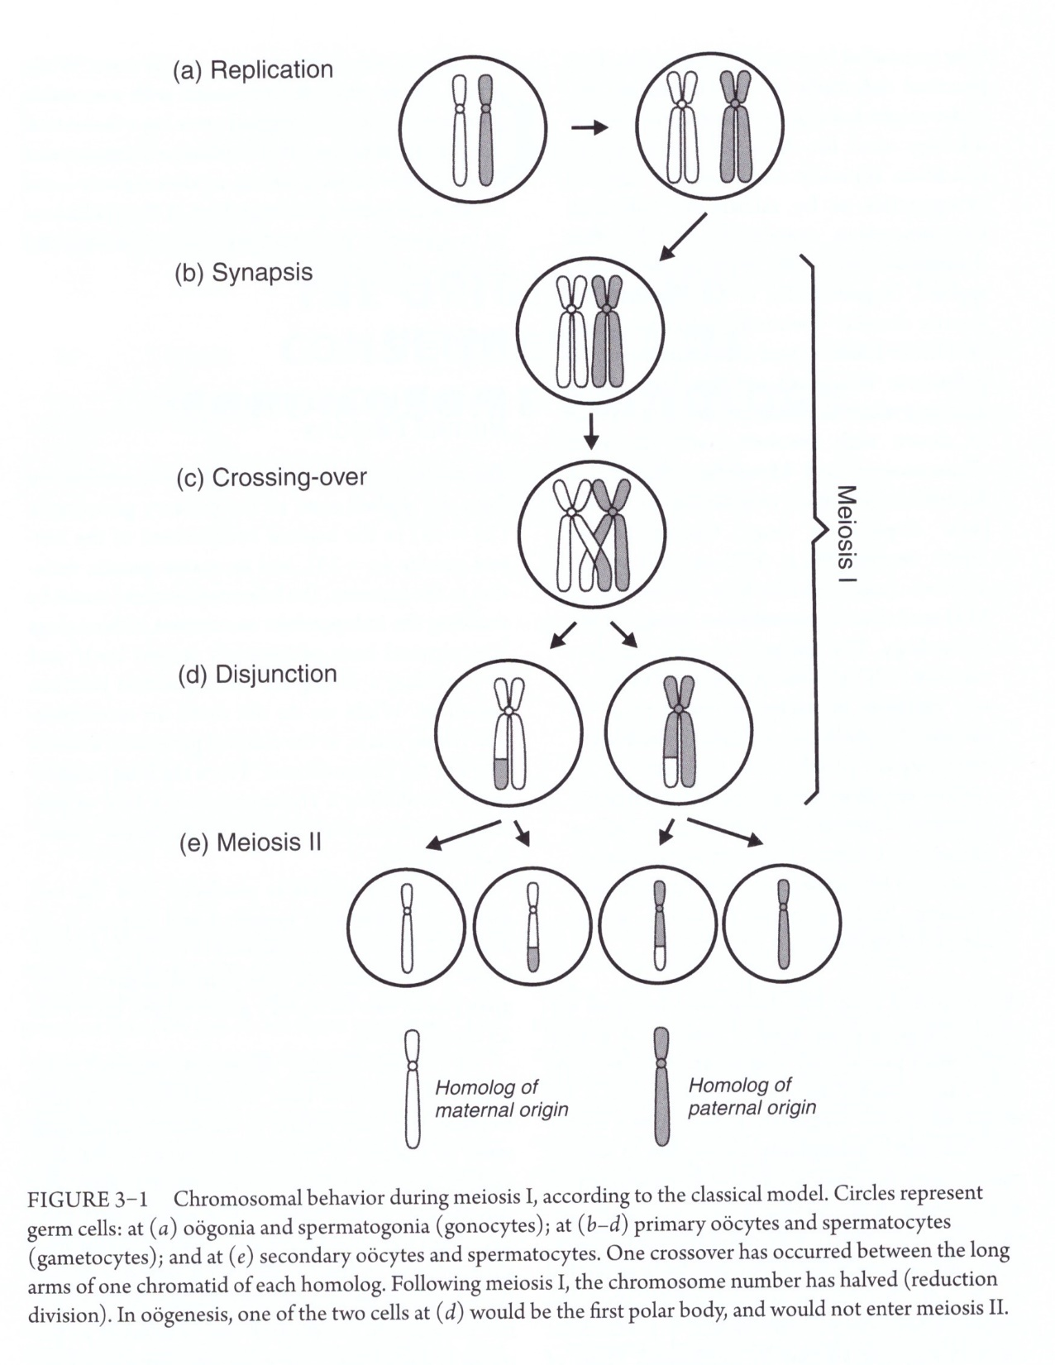
Synapsis
Synaptonemal complex
Bivalents
Recombination
Crossing-over
Desynapsis, dissociation of synaptonemal complex and chiasmata formation
Disjoin, disjunction, segregation
Nondisjunction
Malsegregation

Slide 4
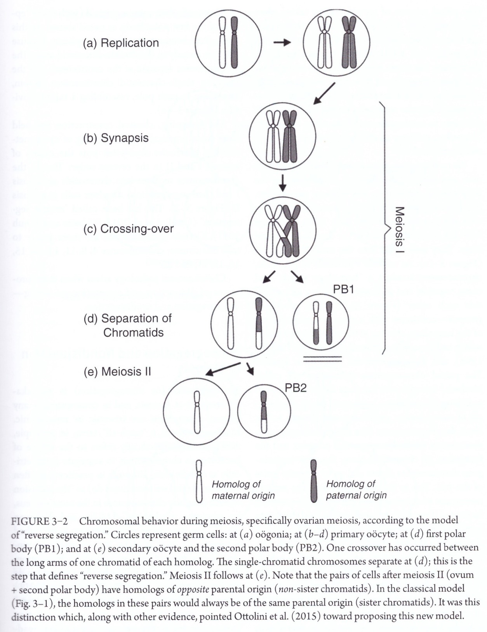
Reverse segregation

Slide 5
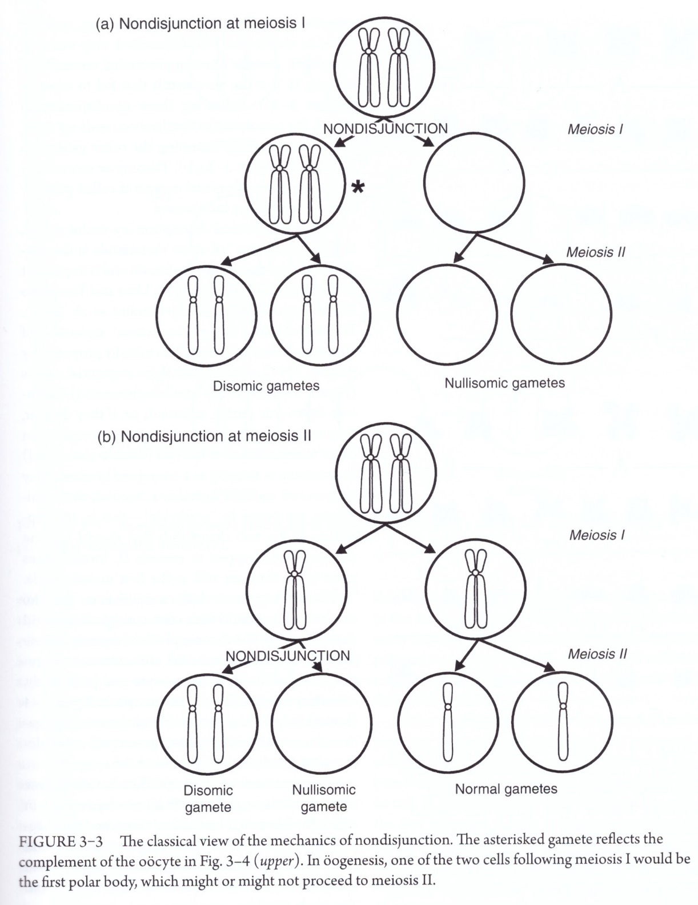
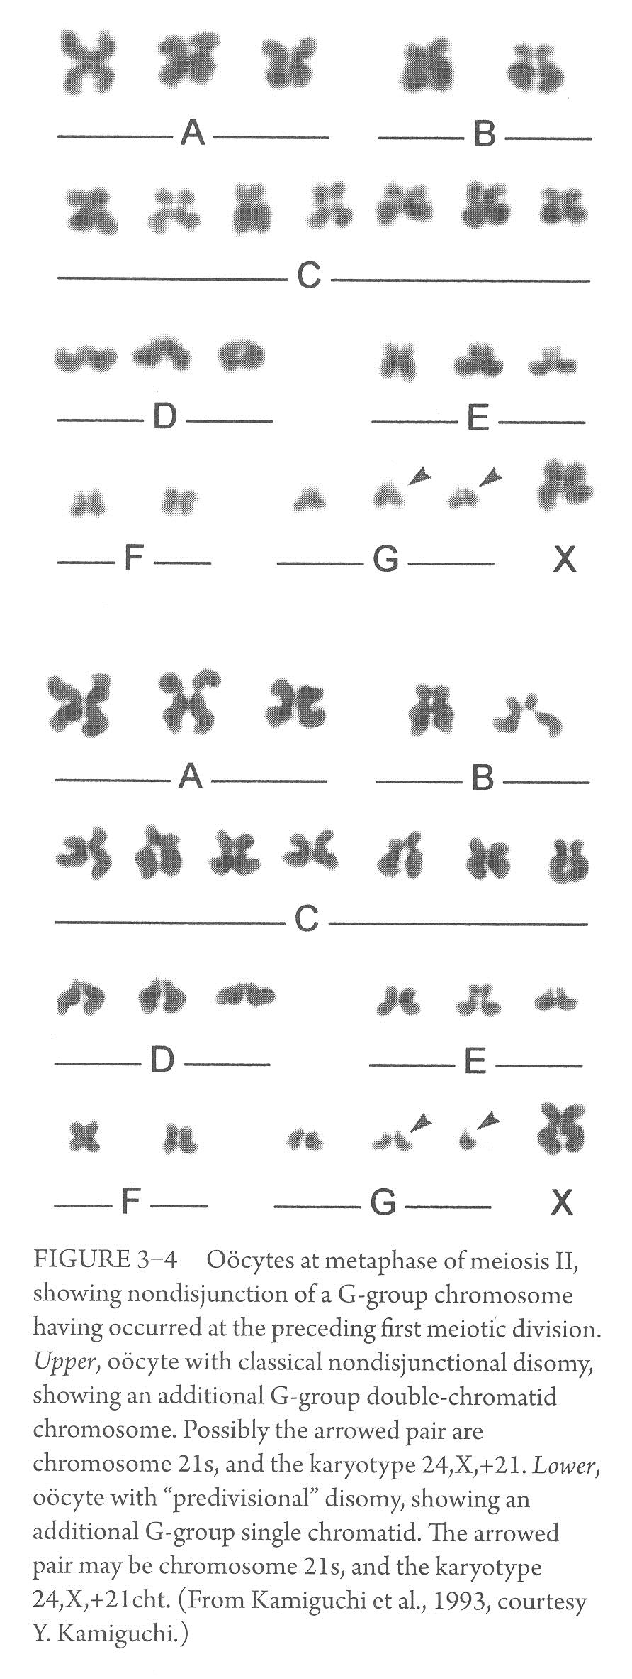
Nondisjunction in meiosis
Nondisjunction: failure of homologous chromosomes or sister chromatids to segregate symmetrically at cell division
Metaphase II

Slide 6
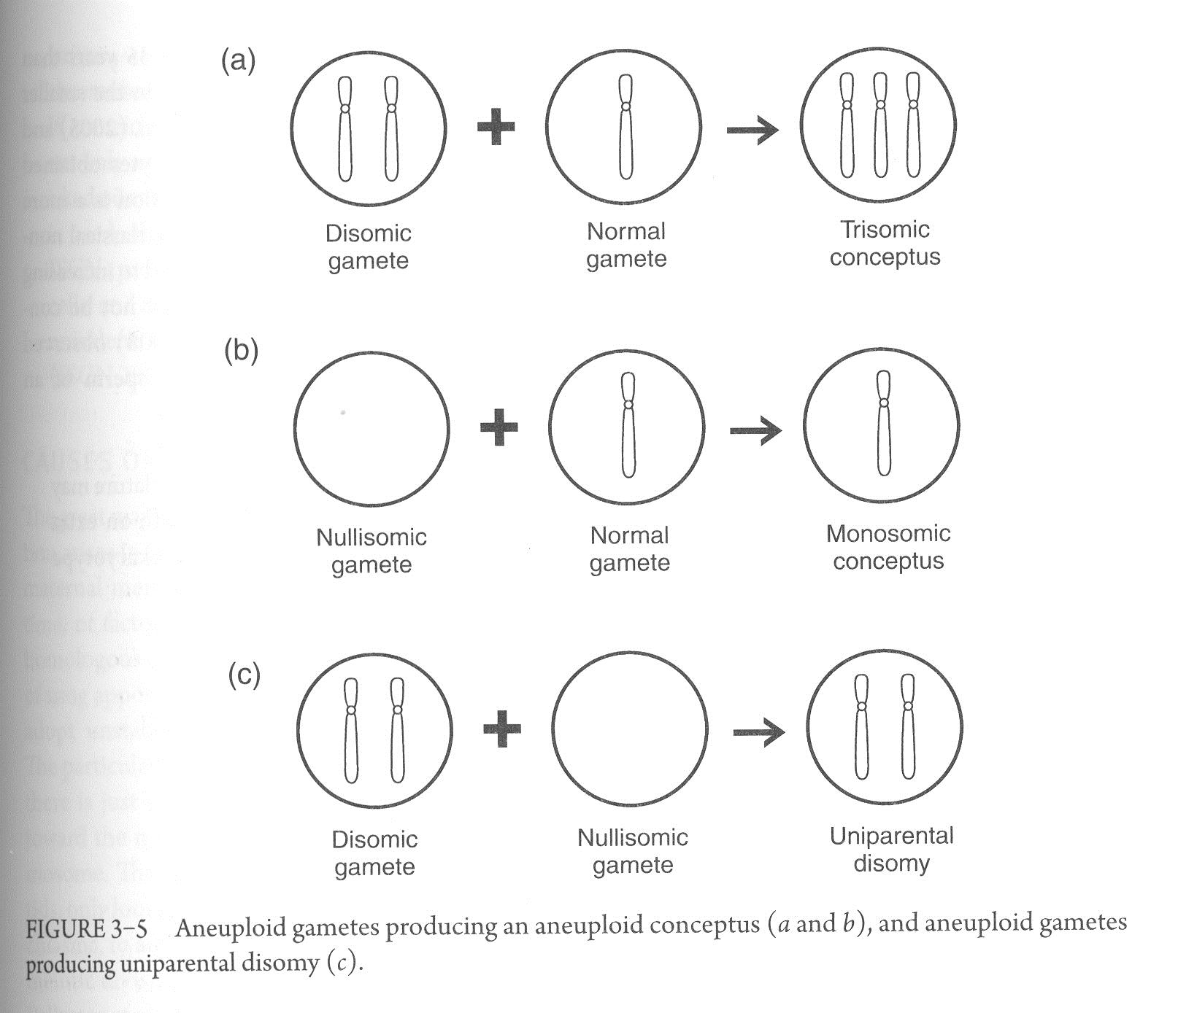

Slide 7

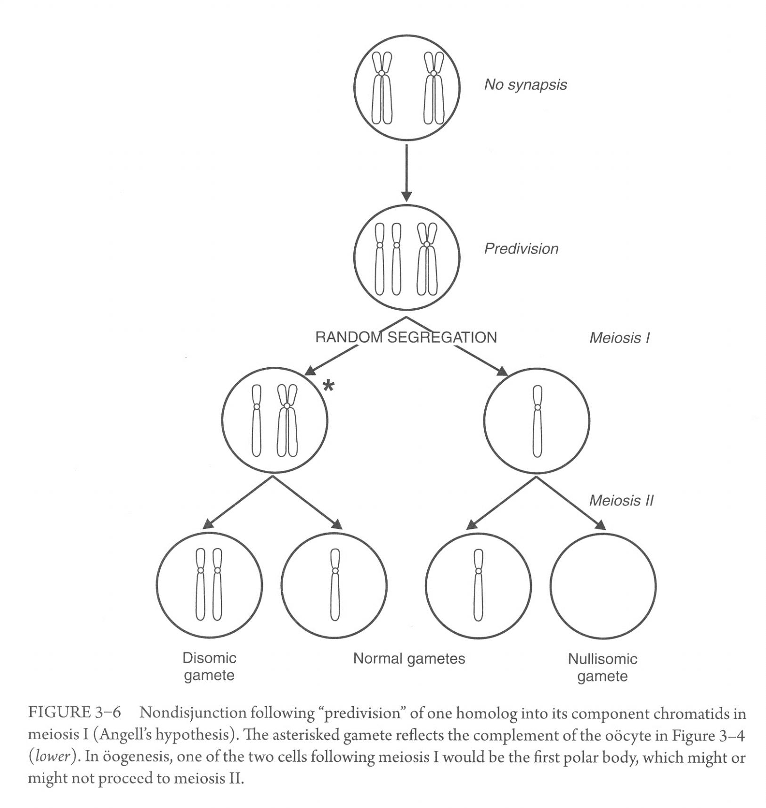
Chromatid “predivision” hypothesis

Slide 8
The majority of human malsegregation takes place in oogenesis
Women in their twenties, meiosis I errors are predominant
Women in their forties, meiosis II errors are predominant
Women aged 28-37, 47% of eggs are disomic or nullisomic
Women aged 38-47, 78% of eggs are disomic or nullisomic
Multiple aneuploidy are known
Sequential nondisjunction at both meiotic divisions could lead to tetrasomy, this is the basis of some X chromosomal polysomy
Complete nondisjunction, could lead to triploidy, retention of polar body within the ovum
Simultaneous parental nondisjunctions a rarer source of double aneuploidy

Slide 9
Causes of nondisjunction
Most aneuploidy due to nondisjunction arises in oogenesis
Vulnerability of maternal meiosis lies in the degradation, over time, of factors that support the adhesion of the homologous chromatids of the bivalent
Compromised function of spindle apparatus could cause aneuploidy
Mutations in genes coding for synaptonemal complex proteins

Slide 10
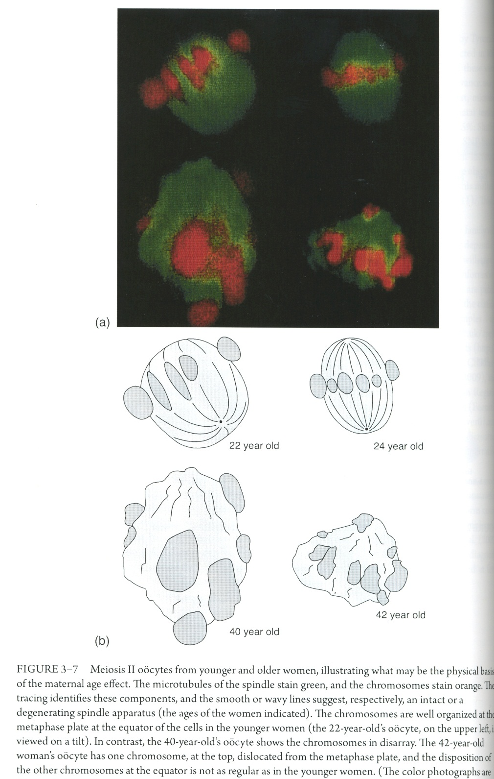
Researchers sampled oocytes at meiosis II metaphase from younger (20-25 years) and older (40-45) women
Looked at the nature of the spindle and the metaphase chromosomes as a whole
Found: symmetrical and neatly arrayed complex in younger women, while in older women the spindle was skewed and the chromosomes in a mess

Slide 11
Meiosis in chromosomally abnormal persons
First, phenotypically normal person heterozygous for a balanced structural rearrangement
heterosynapsis, homosynapsis
Second, phenotypically normal or mildly abnormal person with molecularly-defined microdeletion or micro duplication
not known to interfere with normal cell division

Slide 12
Nondisjunction in mitosis and the generation of mosaicism
Difference between mitotic and meiotic errors:
Mitotic produce mosaic conceptus, meiotic produce a nonmosaic abnormality
The earlier in embryogenesis that a mitotic error occurs, the greater the likelihood for a substantial fraction of the soma to be aneuploid, leading to increasing departure from normality of the phenotype

Slide 13
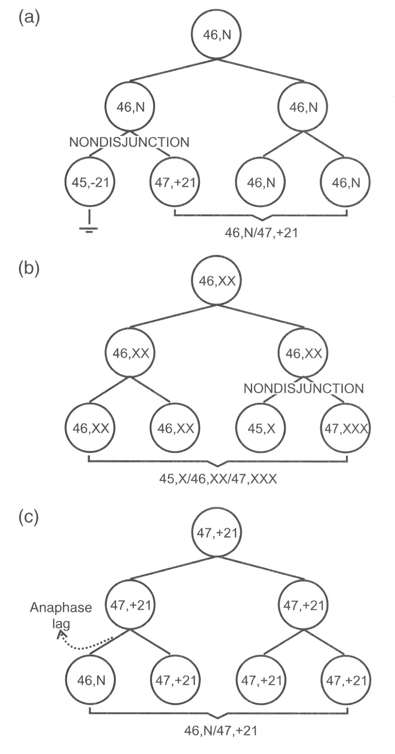
Nondisjunction in mitosis
Mitotic nondisjunction is the major mechanism causing mosaicism
(a) and (b) initially normal zygote, (c) initially aneuploid zygote
In (b), if nondisjunction happen at first division then no 46,XX will be observed. Having some cells 46,XX indicates that nondisjunction happened later than the first division
Same applies to 46,XY zygote with either X/XYY or X/XY/XYY

Slide 14
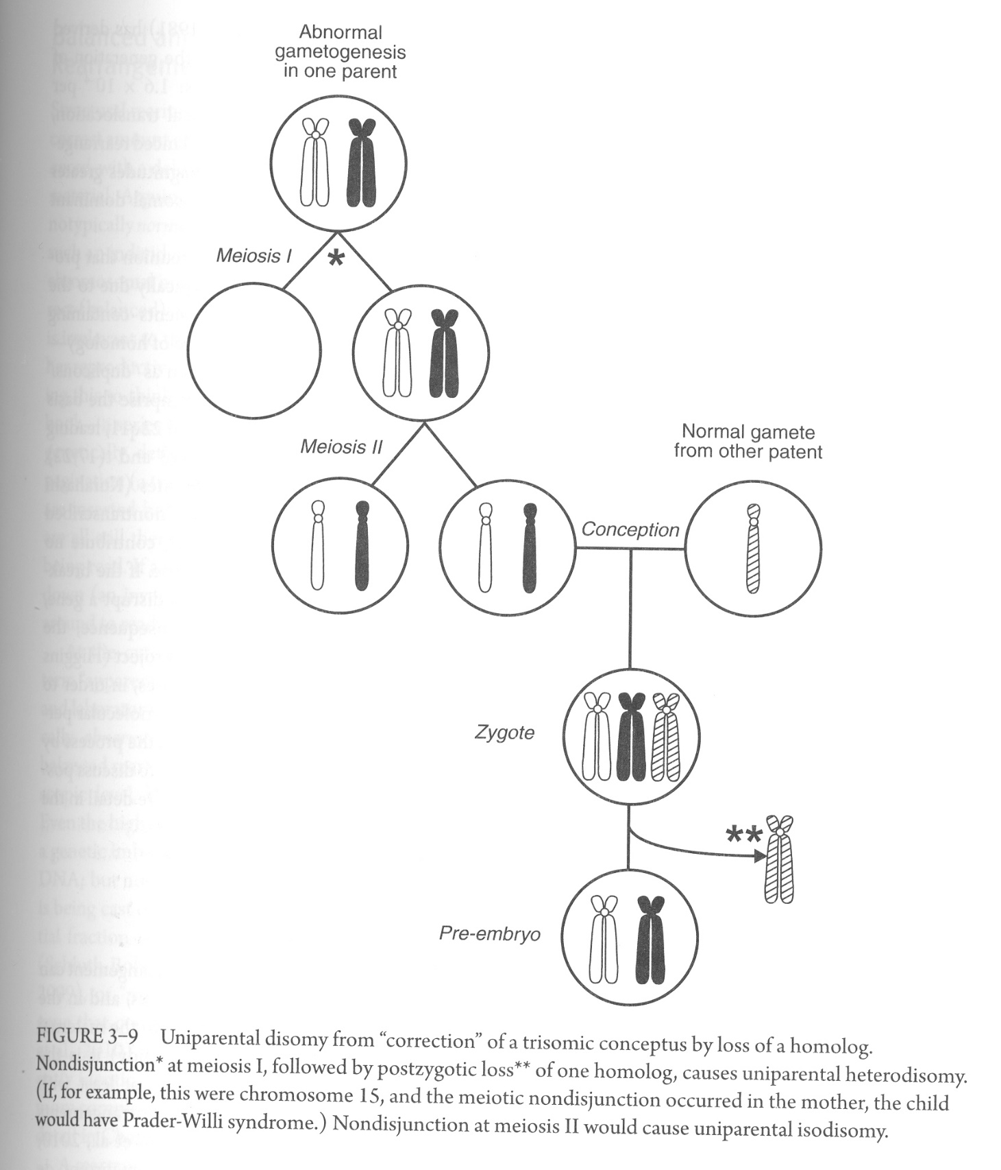
Generation of UPD as a result of trisomic rescue
Inference of rescue may be made in cases of UPD discovered because of isozygosity for a recessive gene
Postzygotic correction can happen in the other direction: to convert a monosomic zygote into a disomic one
45,XO to 46,XX

Slide 15
Mosaicism could happen in the first divisions of the zygote – lessons from IVF embryos
Gonadal mosaicism
Gametocytes undergo around 30 cycles of division producing 2³⁰ (1 billion) cells
If a mutation occur in the 20th division, its progeny go through 10 more divisions resulting in 2¹⁰ (1 thousand) cells – resulting in one millionth abnormal

Slide 16
Chimerism: coexistence of more than one cell line in an individual, due to the union of two originally separate conceptions
Tetragametic 46,XX//46,XX chimera, most probably normal
Twin blastocysts contact and fuse, or
Two sperms fertilizing an ovum and a polar body

Slide 17
Chimerism case:
Mother-son HLA mismatch, suggest not real mother.
Mother ovaries comprised tissue from both fused conceptuses, but blood-forming tissue came from only one
Confined chimerism: Only one tissue, mostly blood, possesses the two cell lines. Dizygotic twins may have intimately opposed placentae, allowing vascular connections to form between them
A woman is XY in almost all her peripheral lymphocytes, but XX in other tissues including ovaries. Had a twin brother, who died as a neonate.

Slide 18
Twining
Occasionally monozygous twins with chromosomally abnormal karyotype will be concordant
Sometimes, monozygotic twins would be discordant for the karyotype!
e.g. monozygous twin, one with 46,XY and one with 47,XY,+21
a) initially 47,XY,+21 conceptus underwent splitting, with loss of a chromosome 21 in one embryo
b) a mitotic nondisjunction occurred in one monozygous embryo from an initially normal conception

Slide 19
Structural rearrangement
Translocations Insertions
Inversions Isochromosomes
Duplications Deletions
Complex rearrangements
Illegitimate breakage and reunion is typically due to apposition of nonmatching (nonhomologous) chromosomal segments, but which do happen to contain DNA sequences with high degree of homology (low copy repeats) – “paralogous sequences” “duplicons” “segmental duplications”
Non-allelic homologous recombination
Most breakpoints are in nontranscribed DNA with no effect on phenotype

Slide 20
Balanced and unbalanced rearrangements
Apparently balanced
Gene disruption or Position effect
Microdeletions and microduplications of incomplete penetrance and variable expressivity
A slightly abnormal person might be considered to represent nonpenetrance or penetrance of very mild expressivity
“Two-hit” hypothesis
An autistic son of parents, each with minor attention deficit, was affected due to having inherited a CNV from each of them

Slide 21
Epigenetic
DNA sequence of a particular gene remains unaltered, but the capacity of this gene to be expressed is altered
Genomic imprinting
Genes in the chromosomal segment are expressed, or not expressed, according to whether the chromosome had been transmitted in the sperm or in the ovum (parent-of-origin effect)
Biallelic gene expression is the norm
Monoallelic gene expression is the exception (imprinted genes)
The imprinting pattern may be specific to a certain tissue, or to a certain developmental stage
Imprint is re-established in each subsequent generation depending on sex of parent

Slide 22
Three categories of functional genetic defects connected to imprinting:
Uniparental disomy will lead to either biallelic expression, or no expression at the locus within the imprintable segment
Deletion at the imprinted locus
Relaxation of imprinting allows a segment that should be nonexpressed to lose its imprint

Slide 23
Consequences of genetic abnormality
Structural imbalance
Many genes are dosage sensitive
Incorrect amount of dosage-sensitive genetic material in every cell of the conceptus distorts its development to a greater or lesser extent
Large losses or gains almost invariably set early anatomical development so awry that natural abortion occurs
Lesser imbalances may be compatible with continued intrauterine survival, but with the eventual production of phenotypically abnormal child
Mental defect is the almost universal consequence of classical autosomal imbalance

Slide 24
Assessment of imbalance
Previously, quantitative assessment of imbalance
What is a large or a small degree of genetic imbalance
Quantitative – how much material is involved?
Haploid autosomal length (HAL)
Chromosome 1 comprises 8.5% of HAL
Chromosome 21 comprises 1.9% of HAL
If imbalance consists of less than 1% of HAL (~30 Mb), the conceptus is often viable in utero, and live birth frequently results
If imbalance is greater than 2%, in utero lethality, with spontaneous abortion, is likely
Autosomal deficiency is much less survivable than is duplication

Slide 25
A firmer assessment is based on empiric observations of phenotypes
Some regions in the genome are more gene-rich than others, hence, abnormality herewith has more impact
Trisomy 13, 3.7% of HAL, frequently goes through live birth.
13q- deletion syndrome, monosomy occurs for 2.5% of HAL
>> low gene density for chr 13

Slide 26
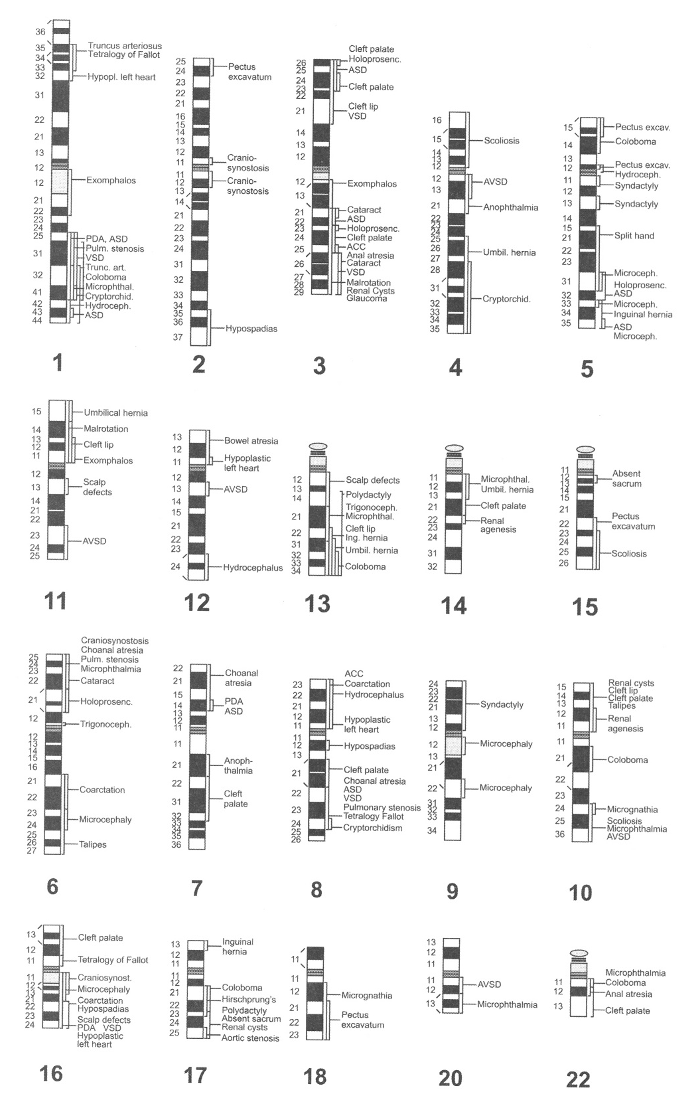
Karyotype-phenotype correlations for deletions and duplications
Differing lengths of deleted or duplicated segments enable a dissection of the specific segmental contributions to components of an abnormal phenotype
A malformation map
A duplication-malformation correlation map

Slide 27
Any X chromosomes in excess of one are genetically inactivated
Y chromosome: its active genetic material is confined to only a small segment, genes being mostly related to sex determination and testicular function
45,X has a high in utero lethality, Turner syndrome, mild phenotype
Phenocopies: similar phenotypes may flow from different genotypes. e.g. Pseudotrisomy 13
A non-genetic condition resembling a genetically determined one

Slide 28
The mosaic state
Whether mosaicism matters depends upon which tissue, and how much of that tissue, is abnormal
An individual with an aneuploid line in only some tissues is likely to have a less severe but qualitatively similar phenotype to some one with the nonmosaic aneuploidy
Some aneuploidies can only exist in the mosaic state, the nonmosaic form being lethal in utero e.g. trisomy 8
Mosaicism excluding the bone marrow will give a normal blood karyotype, and vice versa mosaicism confined to marrow would be seen on routine peripheral blood analysis, but not on other samplings
In sex chromosome mosaicism, fertility can exist when otherwise infertility is the rule e.g. Turner and Klinefelter

Slide 29
An interesting case of mosaicism for a structural rearrangement is that in which two lines of opposite imbalance coexist, with or without a normal cell line
e.g. 46,XY,del(7q)/46,XY,dup(7q)
(by age 12-14 months, deletion cell line disappeared, at least from blood)
Having no normal cell line suggest mosaicism resulted at the first mitosis of the zygote
Analysis of tissues other than blood can clarify the picture of mosaicism

Slide 30
Gonadal (and somatic-gonadal) mosaicism
Gonadal mosaicism happen when an abnormality arises during the formation of a germ cell prior to the onset of meiosis which would result in an abnormal cell line establishment and occupation of a apart of the gonad
Somatic-gonadal mosaicism: if the abnormality arose in embryogenesis prior to the differentiation of the germ cell line, the soma may also be involved

Slide 31
Gonadal mosaicism can also arise due to correction of an initially trisomic conception
A clinical observation supporting this conclusion: low-level mosaic mothers (who had nonmosaic Down child) are of a typical maternal age range, whereas their mothers were of older maternal age at the time their daughters were born. Consistent with their daughters being conceived as (maternal-age-influenced) trisomy 21
Gonadal mosaicism is suspected upon the observation of a chromosomally normal couple (on blood testing) having had two children with the same abnormal karyotype

Slide 32
The recognition of the same abnormality in somatic tissue of a parent, albeit at low level, naturally allows the inference of somatic-gonadal mosaicism
A woman with several trisomic pregnancies was found to be somatic mosaic with blood karyotype 47,+21[3%] and ovarian karyotype 47,+21[50%]

Slide 33
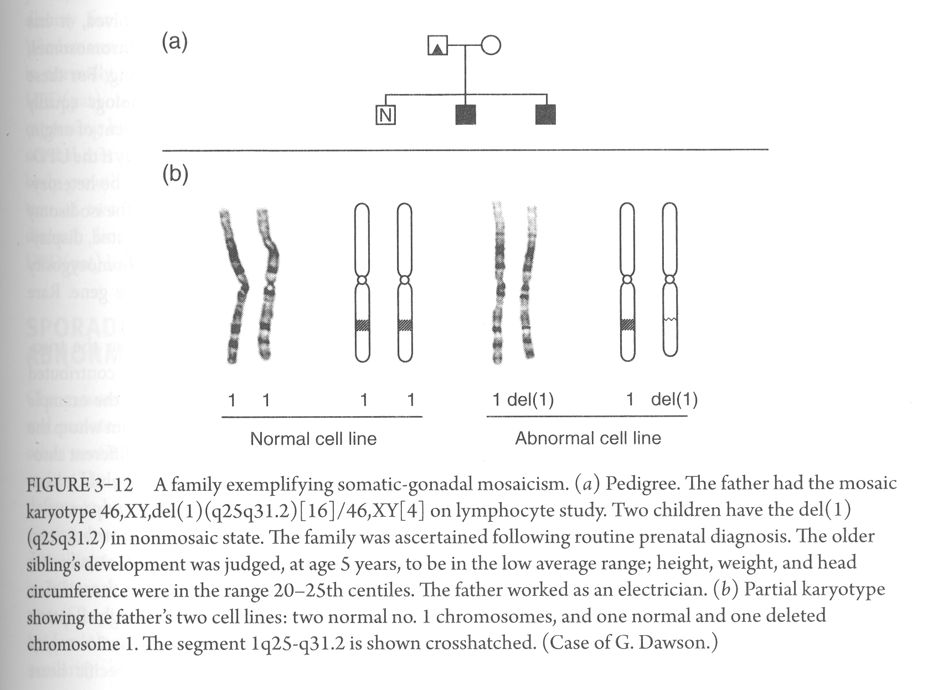

Slide 34
Confined placental mosaicism:
About 1-2% of placentas can have a different chromosomal constitution from that of the embryo with usually the embryo being normal and the placenta trisomic
Qualitative imbalance
Abnormality could be due to unequal parental contributions of an overall correct amount of chromosome material – genomic imprinting, uniparental disomy
Paradar-Willi syndrome – Angelman syndrome
PWS critical region, paternally expressed
AS critical region, maternally expressed
Different but neighboring segments in chromosome 15
Absence of PWS or AS critical region can happen majorly by:
UPD or deletion

Slide 35
Most chromosomes do not appear to be subject to imprinting,
UPD for those chromosomes is not expected to cause problems
With the exception of isohomozygous mutation resulting from isodisomy
Uniparental diploidy – paternal origin – hydatidiform mole
maternal origin – ovarian teratoma
Sporadic and recurrent abnormalities
Trisomy 21 causes
Genes related to regulation of chromosome interaction and separation

Slide 36
